Slide 1
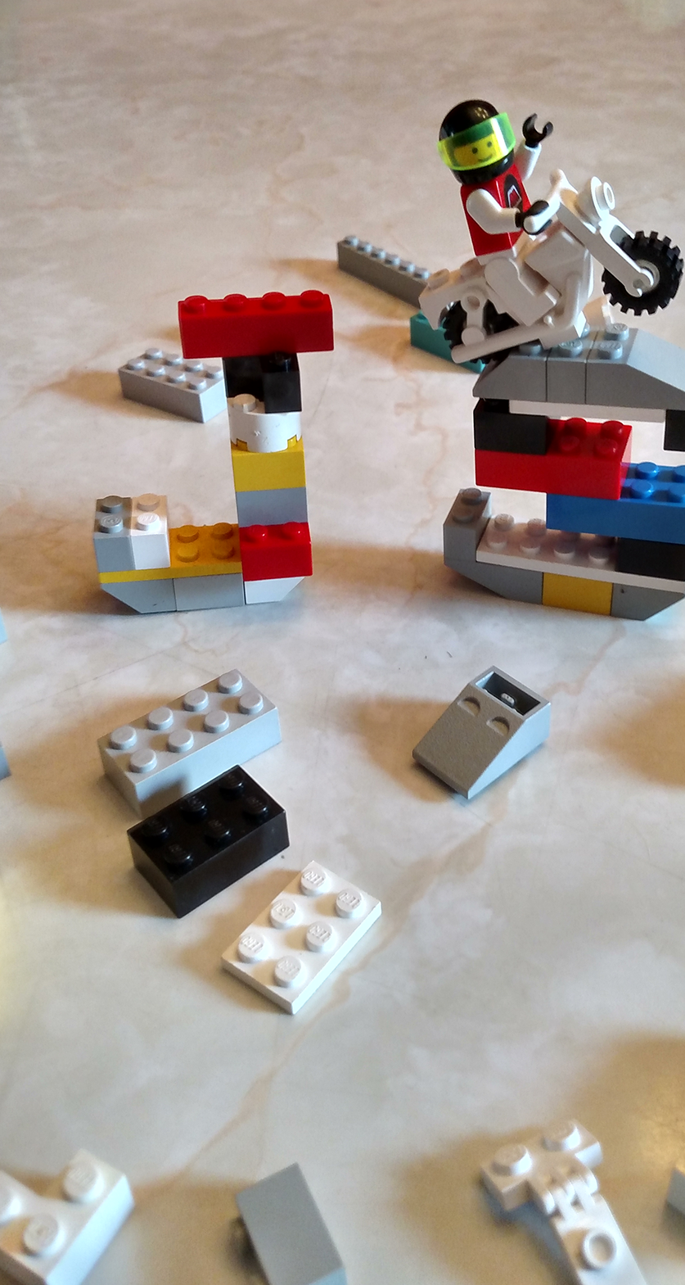
Modular JavaScript; Browserify, RequireJS, ES6 Jeff Valore @CodingWithSpike CodingWithSpike.com

Slide 2


Slide 3



C#
.cs
Build
.exe
Java
.java
.jar
Build
JavaScript
?
.js
Build
.js

Slide 4
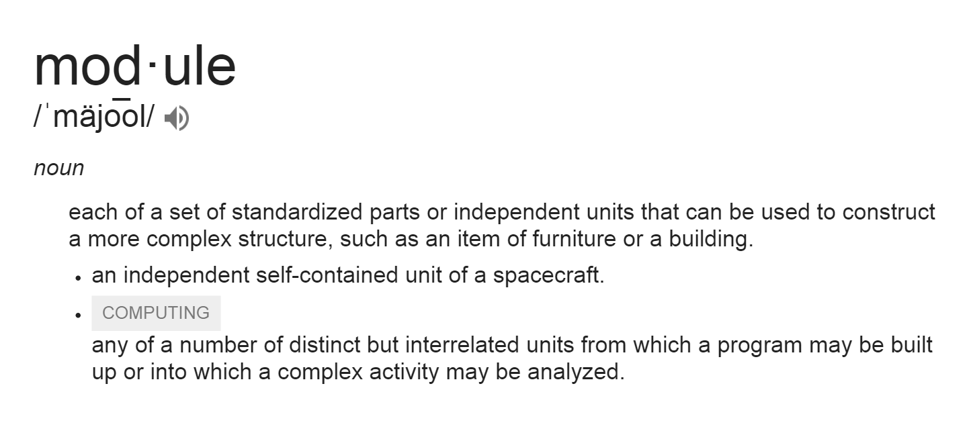
S ingle Responsibility Principle
O pen / Closed Principle L iskov’s Substitution Principle
I nterface Segregation Principle
D ependency Inversion Principle
Notes:
Modules are…
Encapsulate Properties and Functions
Are a JavaScript Object
Can Require Other Modules
Defined in a Single .js File per Module

Slide 5



Slide 6
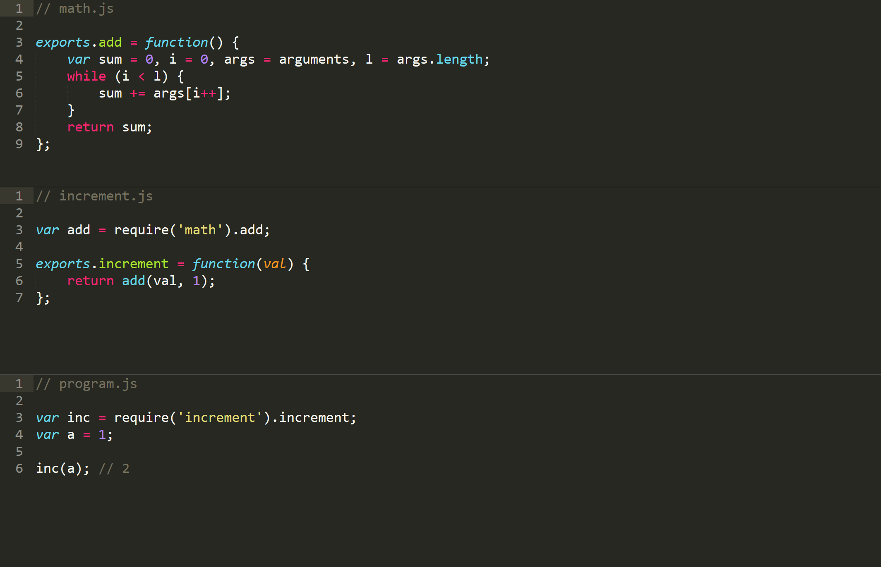

Slide 7



Slide 8
Sample Modules
calculator
multiplication
addition

Slide 9

http://browserify.org/
npm install –g browserify
Notes:
live code demo…

Slide 10
Browserify Module Loading
Module names that start with a ‘.’ are loaded as a relative path from the file that required it.
Module names that do not start with a ‘.’ are loaded from the installed npm modules.

Slide 11

Asynchronous
Module
Definition

Slide 12
http://requirejs.org/
Notes:
live code demo…

Slide 13
RequireJS Module Loading
Relative to HTML document if module name:
Ends in “.js”
Starts with “/”
Contains a protocol (http:)
Else:
baseUrl = location of “main” module, unless specified by configuration
baseUrl + moduleName + “.js”
“paths” configuration can override portions of moduleName

Slide 14
r.js – The Require.js Optimizer
http://requirejs.org/
npm install –g r.js
Notes:
live code demo…

Slide 15

Modules of The Future! EcmaScript 6

Slide 16
ES6 Module Loading
Uses `exports` and `imports` statements.
No browsers implement ES6 module loading yet.
Modules would each require an additional server request unless HTTP 2 is available (IIS in Win 10, NGINX in 2015, Apache in alpha with mod_h2).
Require.js and Browserify can both use ES6 modules now via plugins and transpilers.

Slide 17
Browserify vs RequireJS
 | Browserify | RequireJS
Less configuration | 
More flexibility |  | 
Need dynamic loading at runtime |  | 
Simple syntax | 
Using or sharing code with Node.js | 

Slide 18



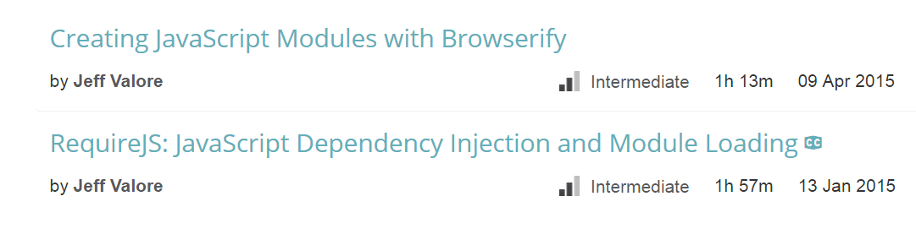
http://pluralsight.com/authors/jeff-valore
@CodingWithSpike

Slide 19
Modular JavaScript; Browserify, RequireJS, ES6 Jeff Valore @CodingWithSpike CodingWithSpike.com pluralsight.com/authors/jeff-valore

